Slide 1
National History Day in Indiana
Bethany Hrachovec
Coordinator, Education and National History Day in Indiana
nhdi@indianahistory.org
Notes:
I am your new National History Day in Indiana coordinator.
Bethany Hrachovec (Pronounced: Rock-uh-veck)
You can reach me at:
317.233.9559
bhrachovec@indianahistory.org
nhdi@indianahistory.org

Slide 2
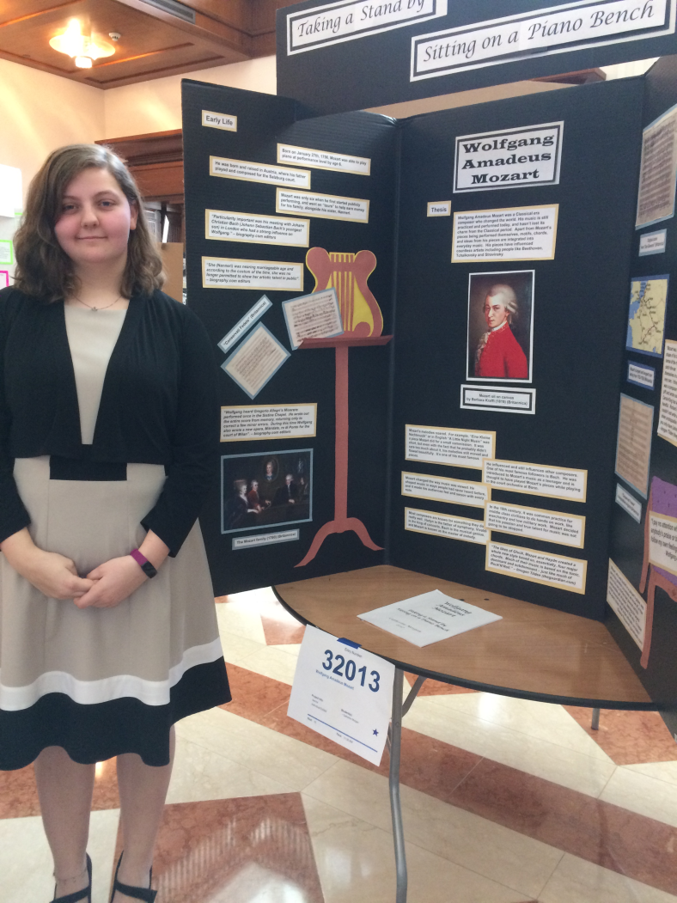
Tailored to your interests
Art
Music
Politics
Science
War
Civil Rights
Religion
Notes:
Teachers, as well as students, get a lot of freedom in choice with National History Day. Teachers can limit students to a specific time period, a specific sub-topic in history, or let their students have free reign.
“History” for the purposes of National History Day is anything that is at least 20 years old. There has to be some sort of written/visual/oral record of your topic. There are no prehistoric topics, or topics about mastodons and dinosaurs. But if you are researching a paleontologist who made major breakthroughs in identifying dinosaurs, then that’s fair game. History is a part of everything, so students will inevitably find something that interests them about history.

Slide 3
All projects need:
Process Paper
Describe how you created your project
Annotated bibliography
MLA or Chicago Manual of Style

Slide 4
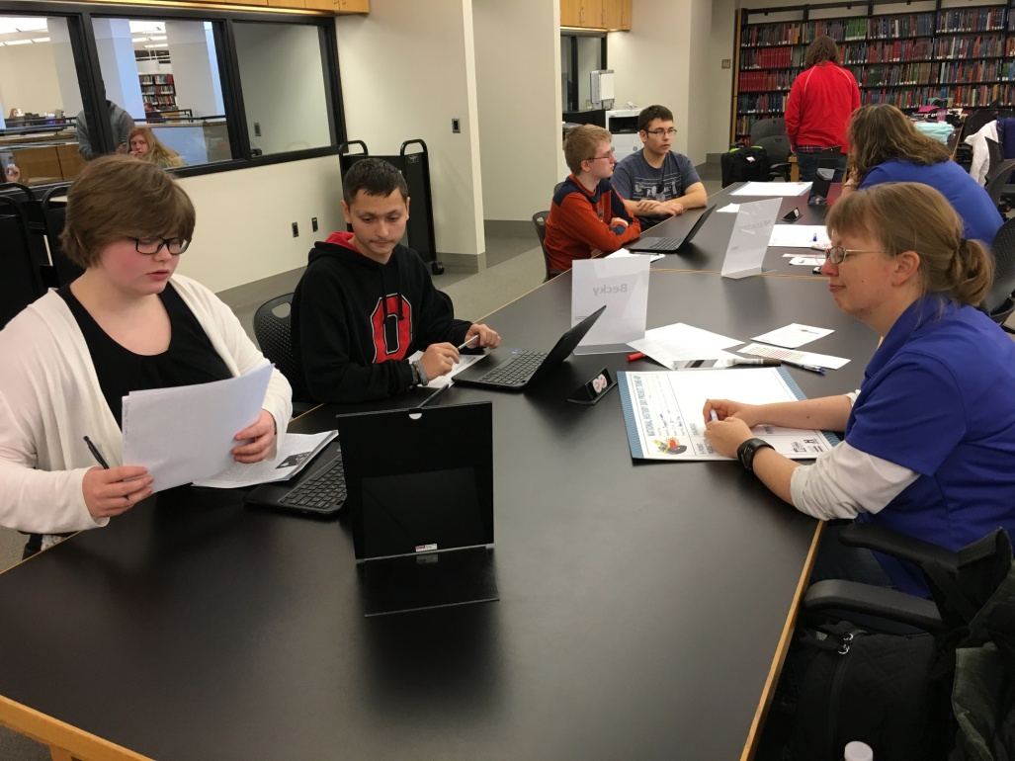
Project Type: Paper
1500-2500 words
Individual work only
Traditional papers and creative writing
Does not need a process paper
Appendix: not required
Footnotes, endnotes, internal citations
Notes:
Students can have 5 different categories of project they can enter. Each project type requires an annotated bibliography. Citations in all projects must be either MLA or Chicago Manual of Style.
Papers
Students may only work individually on a paper. Their paper must be 1500-2500 words in length, not including the bibliography. Students may write a traditional paper or explore elements of creative writing. Regardless of type of paper, they must have a clear thesis statement and argument with supporting evidence.
All projects require an annotated bibliography. While there is no word limit in the annotated bibliography, students are reminded that this is not an opportunity to expand on their topic. Annotated bibliographies describe why the particular source was useful to their project.

Slide 5
Project Type: Website
http://17854214.weebly.com/
Individual or group
1200 word limit
Can be viewed on different browsers
Max 4 minutes of music/video
All media must be cited
Notes:
Website
Students may work individually or in a group of up to 5 students. Students create a free website through the platform “Weebly.” In order for the website to count towards contests, students must create their Weebly website by following the link on the National History Day website. Students may use any media they would like on their website, but they are limited to 100MB of file space. Students are limited to 1200 words on their website, including titles and navigational pages.
With the exception of the “paper” category, all projects require a process paper. The process paper is a 500 word essay describing how students selected their topic, what useful sources they found, what challenges they faced, and how their final product came to be at the state it is.

Slide 6
Project Type: Documentary
10 minutes
Individual or group
Can include dramatization, narration, photographs, film, music
Credits acknowledges sources of media
https://youtu.be/Ck3m0YBFziY
Notes:
Documentary
Students use movie making software, found as basic applications on most computers, and slide-show software to create a 10 minute or less documentary. Documentaries can be created individually or in groups of up to 5 students. Students can include dramatizations (in which they recreate an aspect of their narration), photographs, film clips, and music, among other things. Students must cite their sources at the end of the documentary, included in the 10 minute limit. Students write their own script and provide the voice-over work.
Students submit a process paper and annotated bibliography with their documentary.

Slide 7
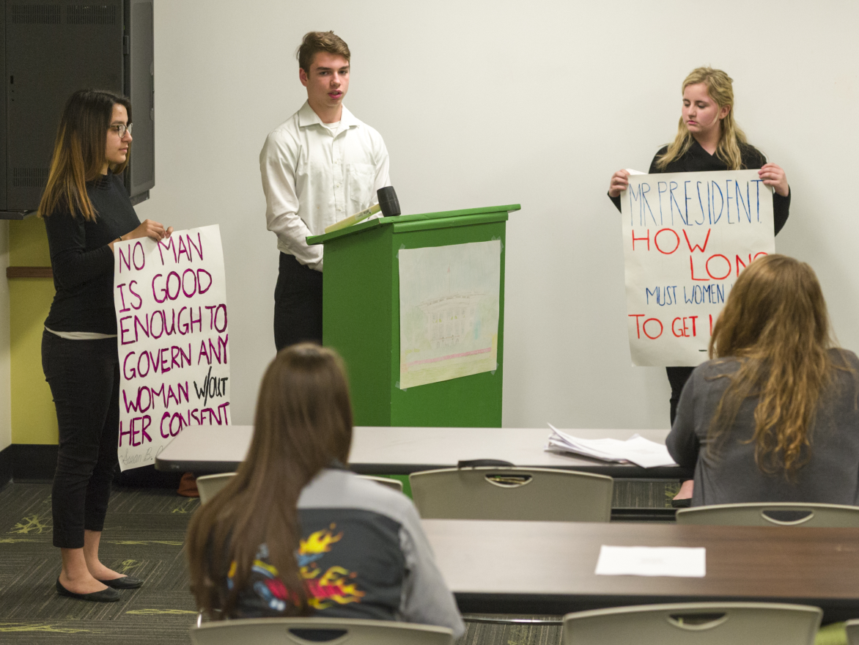
Project Type: Performance
10 minutes
Individual or group
Use props, media, costumes
Can be a historical person, or create a persona
Must be set up and taken down by the students
https://youtu.be/mHkfg8kw9lE
Notes:
Performance
Students can work individually or in groups of up to 5 students to create a performance. Students write and perform their scripts. They can incorporate props, costumes, and media to create a 10 minute or less performance. Students can take on the role of a historic figure, or they can create a new persona of an individual who may have witnessed the historical event.
Students submit a process paper and annotated bibliography when performing.

Slide 8
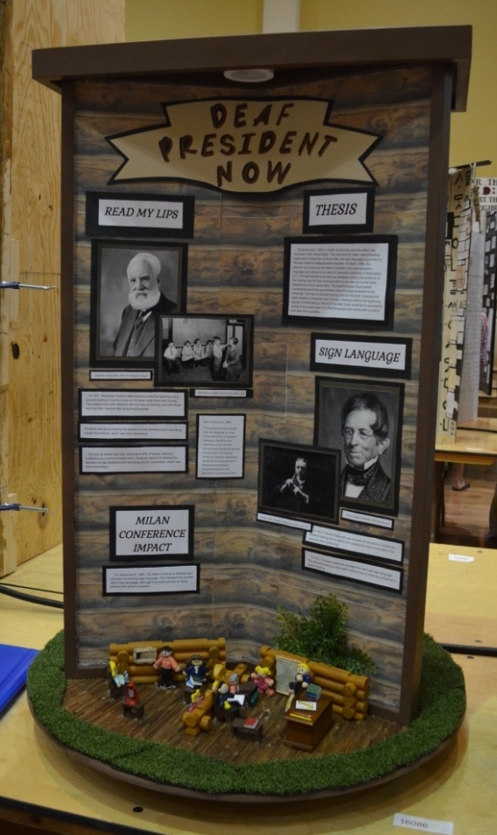
Project Type: Exhibit
Individual or group
Size limit: 40 inches wide, 30 inches deep, 6 feet high
500 word limit
Quotes and credit lines do not count toward limit
Can incorporate media and interactive elements
Notes:
Exhibit
Students can work individually or in groups of up to 5 students. Students only have 500 words they are allowed to put on their exhibit. However, they can use quotes to help support their argument. Students can incorporate media and interactive elements in their exhibit. In the exhibit pictures, students provided thick headphones for viewers to put on and attempt to read their friends’ lips. Anti-bacterial wipes allowed viewers to clean the headphones after they had been used.
Students can create a traditional tri-fold board exhibit, or they can explore different methods of presentation. Students have a size limit of 40 inches wide, 30 inches deep, and 6 feet high. If students create a circular exhibit like the one pictured, it is limited to 30 inches in diameter.
Students submit a process paper and an annotated bibliography with their exhibit.

Slide 9
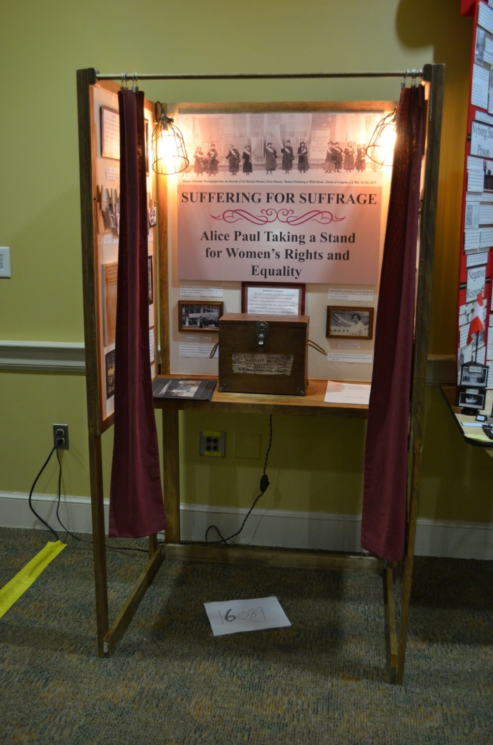

Slide 11
Annual Theme
Northwest Ordinance
Ryan White’s fight for AIDS education
War of 1812
Prohibition
Abolition
Women’s suffrage
Music
WWII Prisoners of War at Camp Atterbury
Notes:
Each year, National History Day selects a theme to help guide students in their topic selection. The 2017-2018 contests year’s theme is: Conflict and Compromise in History. Projects must incorporate both conflict and compromise. Students can choose local, state, national, or global topics. These are just a few examples provided by National History Day. Check www.indianahistory.org/education/history-day for Indiana-related topics that your students can explore using the Indiana Historical Society’s collections.
At the State contest, students can select to be considered for special prizes. For an updated list of special prizes and topics related to them, please visit: http://www.indianahistory.org/education/history-day/student-and-teacher-awards#.WXDXj4jyuM8.

Slide 12
Annual Theme
Conflict AND/OR Compromise
Projects can discuss both, or focus on just one
They do not need to be discussed equally
If the topic includes both, you must talk about both

Slide 13
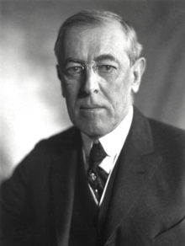
Conflict, Compromise, or Both?
President Woodrow Wilson put forth a speech near the end of World War I. He outlined 14 Points that should be met in order for peace to be achieved in the world. Wilson fell sick during the Paris Peace Conference, where peace negotiations were happening. French Prime Minister Georges Clemenceau took advantage of this to put forth several articles which caused anger throughout Germany. The Treaty of Versailles passed without many of Woodrow Wilson’s points.

Slide 14
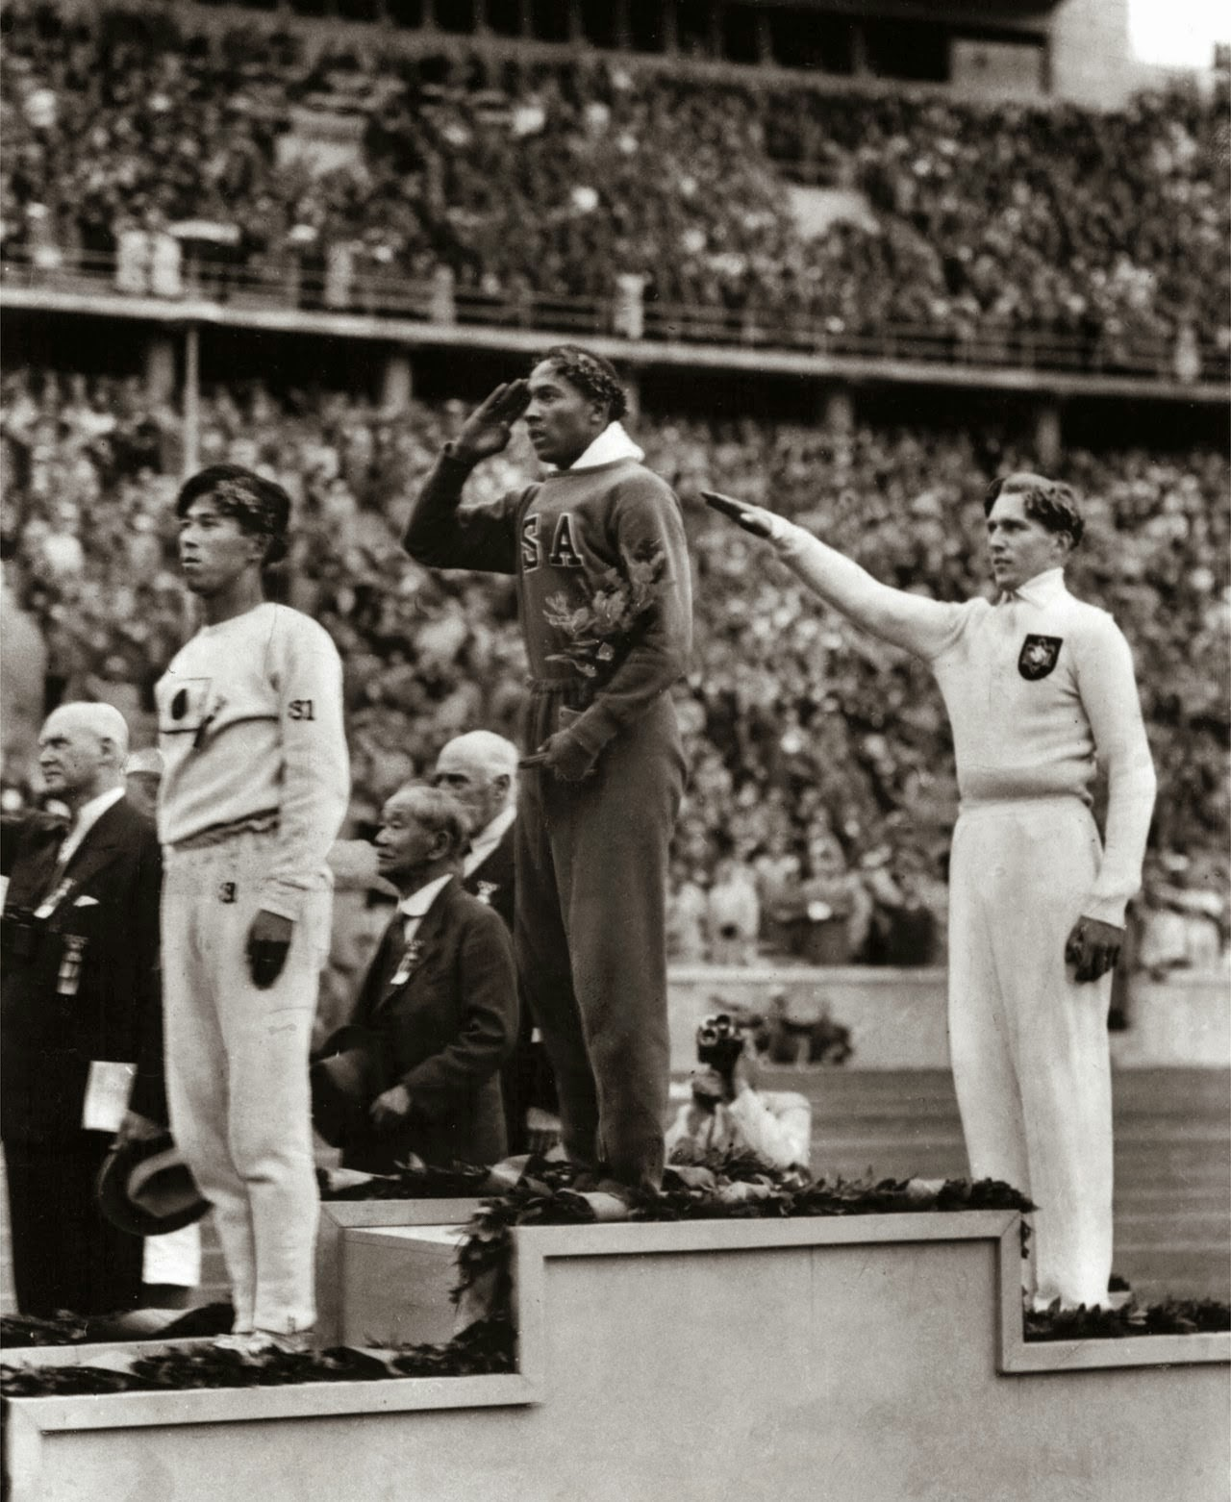
Conflict, Compromise, or Both?
Jesse Owens was an African American Olympic athlete who excelled in sprinting during the 1930s. He participated in the 1936 Summer Olympics in Berlin, Germany, during Adolf Hitler’s reign. Adolf Hitler wanted to use the Olympics to show the world the superiority of the Aryan people. Jesse Owens dominated the Olympics and became the first American to hold gold medals in a track and field event.

Slide 15
Conflict, Compromise, or Both?
Rachel Carson quit her job with the US Fish and Wildlife Service department during World War II when she began to notice the affects of chemical pesticides on the environment. Her previous publications were written in a way that would educate people without boring them with the technical scientific names of the world. She shifted her writings to warning the public on the dangers of the chemical industry.

Slide 16
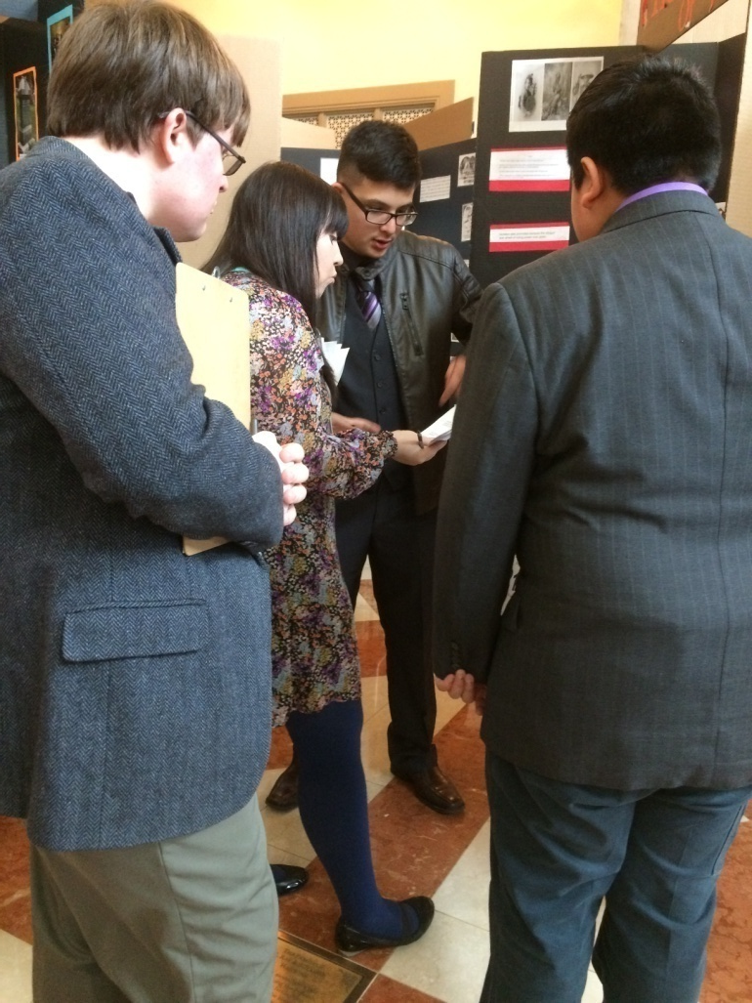
Contest Structure
Judged on 3 elements:
Historical Accuracy – 60%
Relation to Theme – 20%
Clarity of Presentation – 20%

Slide 17
How do I begin?
Research your topic
Primary Sources – Created during time of event or involved someone firsthand
Interviews
Newspapers
Letters
Diaries
Autobiographies
Secondary Sources – Topic overview and background information
Biographies
Encyclopedias
Websites

Slide 18
What do I do next?
Decide on your group and project type
Paper
Exhibit
Documentary
Performance
Website
Competitions
Present in class
Go to a regional contest and compete against other students from around the state

Slide 19
Contact Us
Follow Us
nhdi@indianahistory.org bhrachovec@indianahistory.org
NHDIndiana
National History Day in Indiana
Notes:
National History Day in Indiana students learn new things about themselves, their topics, and their friends. They get to explore new topics in ways that are relatable to them. They get to see how they can make a difference. Indiana has had two separate groups petition Congress directly for a Congressional Medal of Honor for soldiers they had researched. This past year, one of our groups was invited to the White House by Mike Pence to talk about their project. Indiana students make a difference with their projects.
Will your students be among them?
If you have any questions, please do not hesitate to contact me at: bhrachovec@indianahistory.org
OR
nhdi@indianahistory.org
I look forward to working with you in the future!
-Bethany Hrachovec

